Slide 1

Virtual Simulation Experience
STUDENT PREP

Slide 2
PLEASE REVIEW THIS SLIDESHOW PRIOR TO YOU SIMULATION EXPERIENCE
This slideshow will give you an idea how virtual simulation will flow. Feel free to write down any questions you might have and bring it to your learning community during your assigned simulation time!

Slide 3

Zoom Instructions for Virtual Simulation
Zoom Requirements
  Use your ASU Zoom Account
  Ensure most up to date version of Zoom is downloaded and functional
Zoom Functions
  Annotation draw
  Annotation text
  Share screen
  Remote control access
    Your Simulation Nurse will grant one primary nurse remote control in order for you to complete patient skills or assessments utilizing the drag and drop feature
Drag and Drop Feature
  Your Simulation Nurse will grant one primary nurse remote control to utilize drag and drop feature
  Will be required when instructed on slide for equipment selection, medication administration, skill performance, etc.
Technology Support
  If you have experienced any tech issues when participating in virtual simulation experiences, contact tech support in advance to help ensure all zoom requirements are functional
    Contact information: University Technology Help Desk - http://uto.asu.edu/zoom

Slide 4
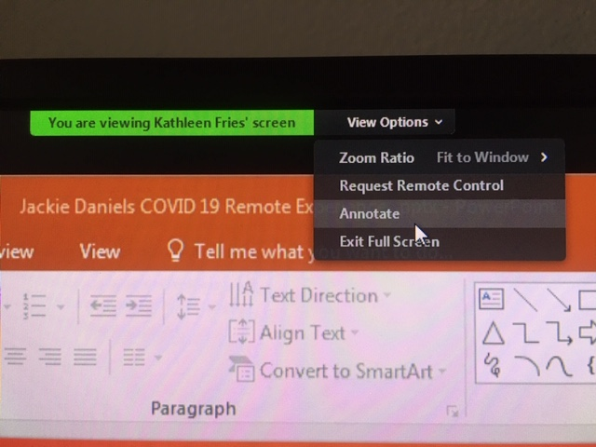
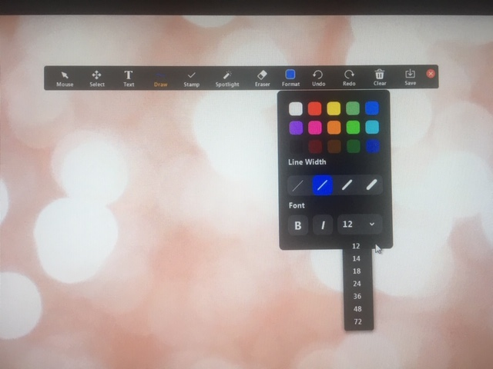
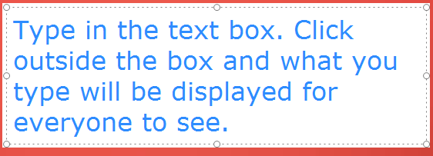
How to Annotate using Zoom
Hover over screen until options come up
Click View Options
Choose Annotate from dropdown box
Text Function
  Choose Text
  Choose Format
  Change Font size to 12
  Click anywhere on the screen where you would like to type
  Type in the box
    Your text will not be displayed for others until you click outside your text box
Draw Function
  Choose Draw
  Use mouse to draw as directed on slide

Slide 5
Remote Control Access on Zoom
What is remote control access?
  This feature gives you the ability to take over control of the Simulation Nurse’s computer screen
  It will be used for drag and drop or other skill performance steps
Who will give control ?
  Your Simulation Nurse will grant one primary nurse remote control access when appropriate
Who will take control?
  One primary nurse
  Prior to entering the patient room, please vocalize which primary nurse you will utilize this feature
Other Important Information
  Your Simulation Nurse will vocalize when this feature will be used throughout the simulation
  When utilizing this feature, there might be a slight delay in your actions, so be patient!
  Once you have completed the skill needed, leave your computer mouse in place while your Simulation Nurse takes back control to advance to the next slide

Slide 6



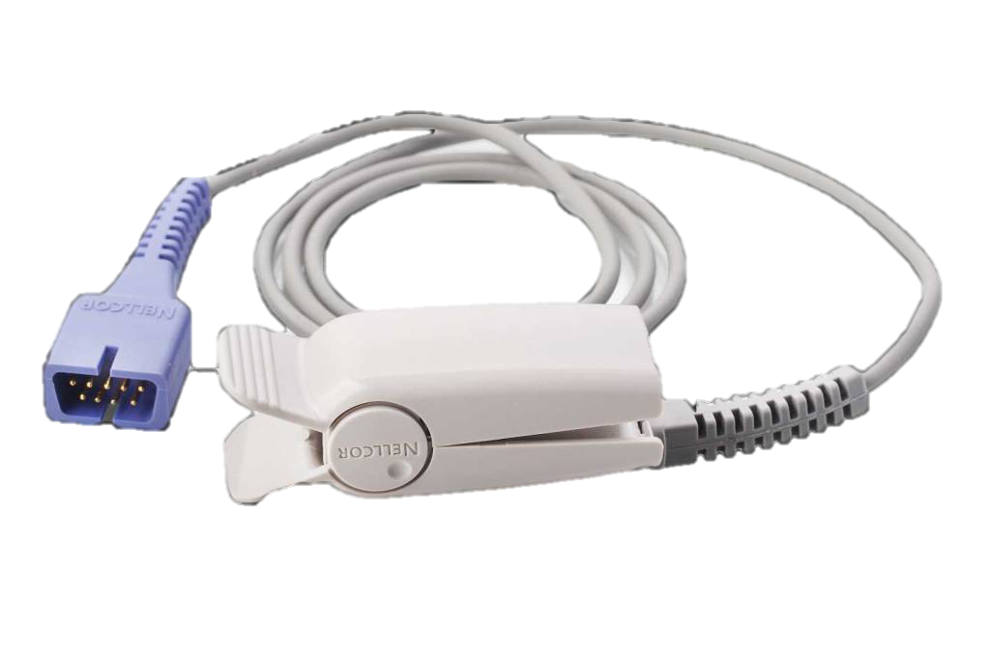

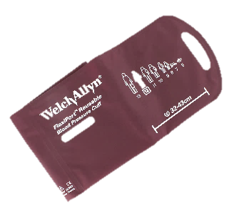

Drag and Drop Practice Example
Drag and drop equipment needed for patient assessment onto patient picture while performing vital signs. Verbalize steps on how to perform skill and use equipment.

Slide 7
Drag and Drop Practice: Completed Example
Drag and drop equipment needed for patient assessment onto patient picture while performing vital signs. Verbalize steps on how to perform skill and use equipment.

Slide 8
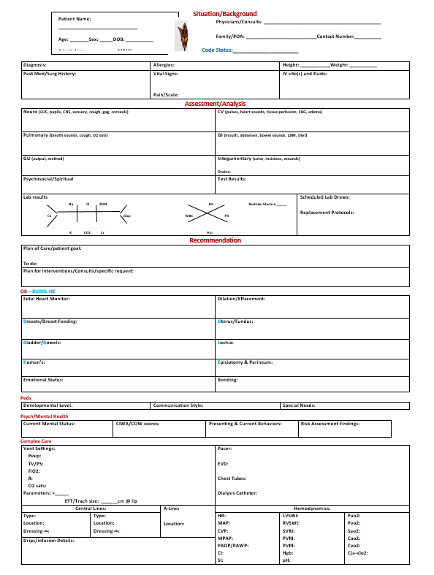
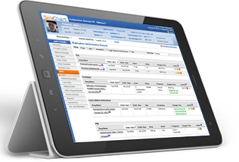
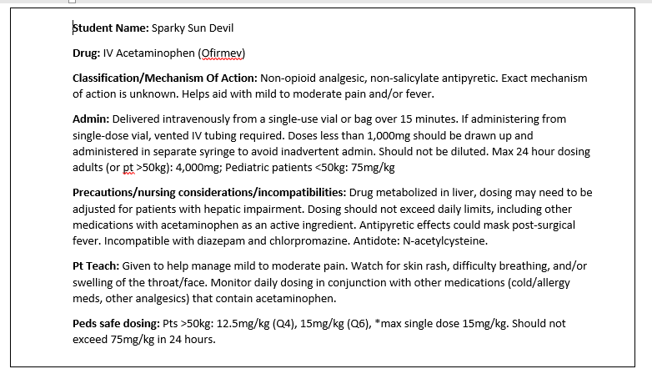
Preparing for Virtual Simulation
Have your SBAR and assigned medication cards completed and accessible
Log into Evolve (NCO-Simulations) prior to joining Zoom at designated simulation time
  Your Simulation Nurse will direct you when to start your simulation in Phase 1 prior to entering virtual patient room
If desired, skills bag items can be used to help demonstrate or describe physical skills performed during simulation

Slide 9

Simulation Timeline
Prebrief: will be directed by your FOR at the start of your simulation time.
  Depending on which simulation you will be doing, prebrief time can vary.
Orientation: will be directed by your Simulation Nurse
  Includes patient room tour, introduction to medication room, introduction to supply cart, etc. Orientation is to help prepare you for what to expect during the simulation.
  Your FOR will assign primary nurse and any other roles that are included in the specific simulation experience prior to starting
Simulation: will be directed by your Simulation Nurse
  Depending on which simulation you will be doing, patient care time can vary.
Debrief: will be lead by your FOR
  This is the time to review what happened during your simulation and will be an open discussion between all learning community members.
  This is one of the most important parts of your simulation experience, so come with an open mind and willingness to learn!

Slide 10
Example of Patient Room Orientation
Vimeo Link:
https://vimeo.com/user65837914/review/424800793/01961dcafe
Password: gracecenter!

Slide 11
Virtual Medication Administration
See next slides for instructions on how to use the Pyxis and administer medications virtually during simulation.

Slide 12
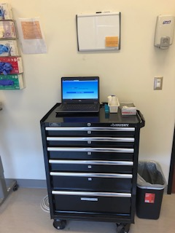
Virtual Medication Administration
Students will need to access the Pyxis and Medication Cart to retrieve patient medications
What is the Pyxis?
  Computerized medication dispensing system
  Link to Pyxis: http://www.asusim.com/medcart/
  Remote control access will be granted by your Simulation Nurse in order to use this feature
What is the Medication Cart?
  Where patient medication is stocked
  Labeled by drawer (letter) and pocket (number) (ex: A12)

Slide 13
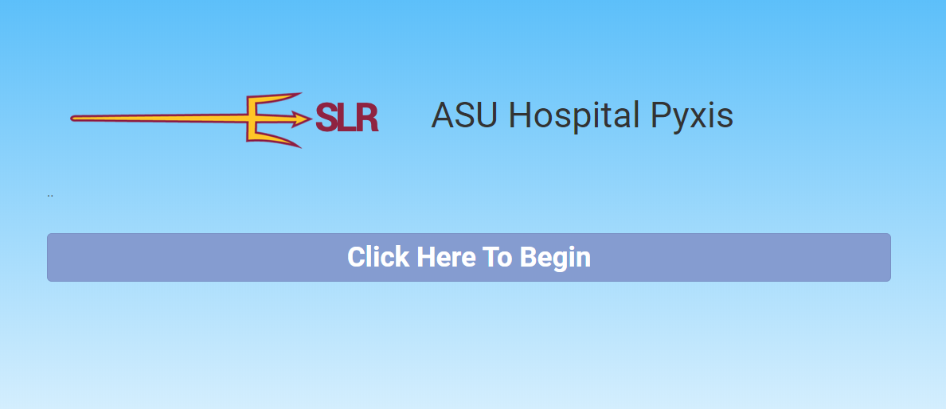
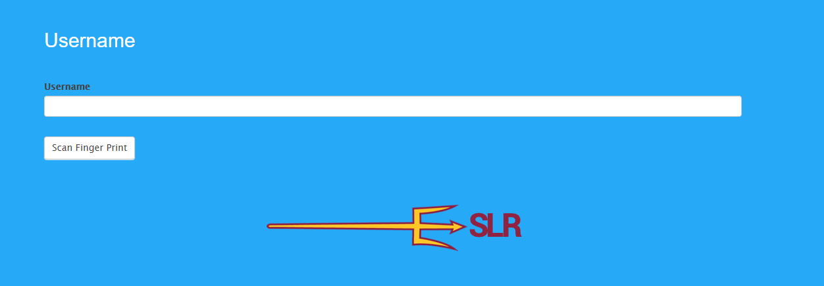
How to Use Virtual Pyxis Continued…
1. Click here to open Pyxis
2. Type in any username (no official username will be given to you)
ASURocks!
3. Click Scan Finger Print

Slide 14
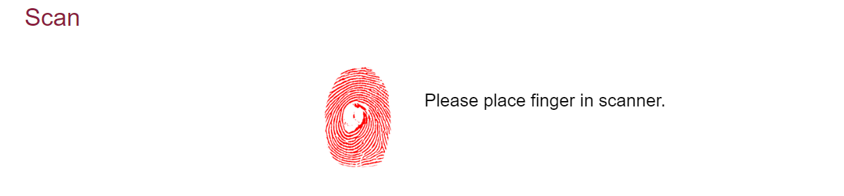
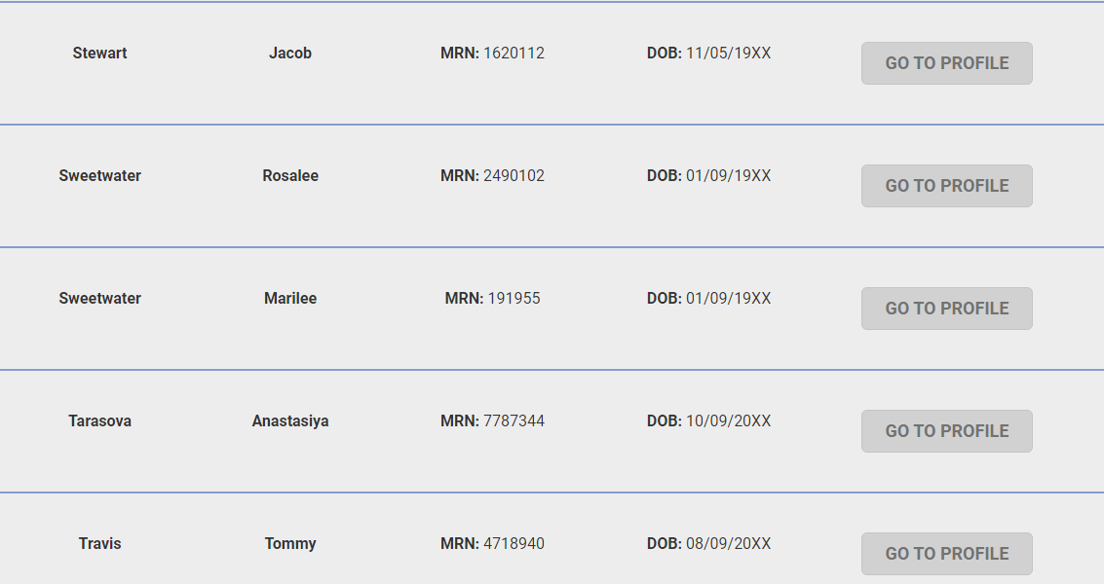
How to Use Virtual Pyxis Continued…
4. Place finger on “scanner”
5. Find patient and click on Go To Profile

Slide 15
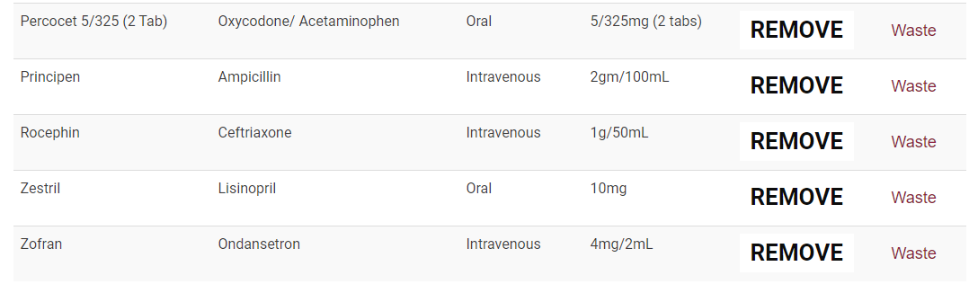
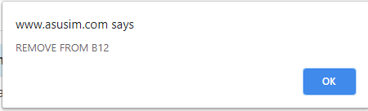
How to Use Virtual Pyxis Continued…
6. Locate medication and click Remove
7. Pyxis will inform you which drawer and pocket to find the selected medication

Slide 16

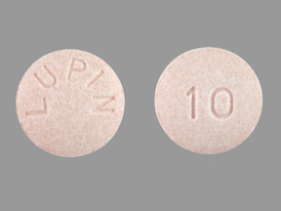
How to Use Virtual Pyxis Continued…
8. You medication will appear on your screen

Slide 17
Now you are ready to administer your medication to your patient!
See next slides for SimChart medication scanning instructions

Slide 18
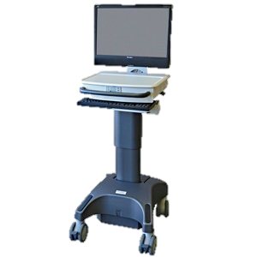


SimChart Medication Administration Steps using e-MAR
SimChart
Barcode Scanner
WOW (workstation on wheels)

Slide 19
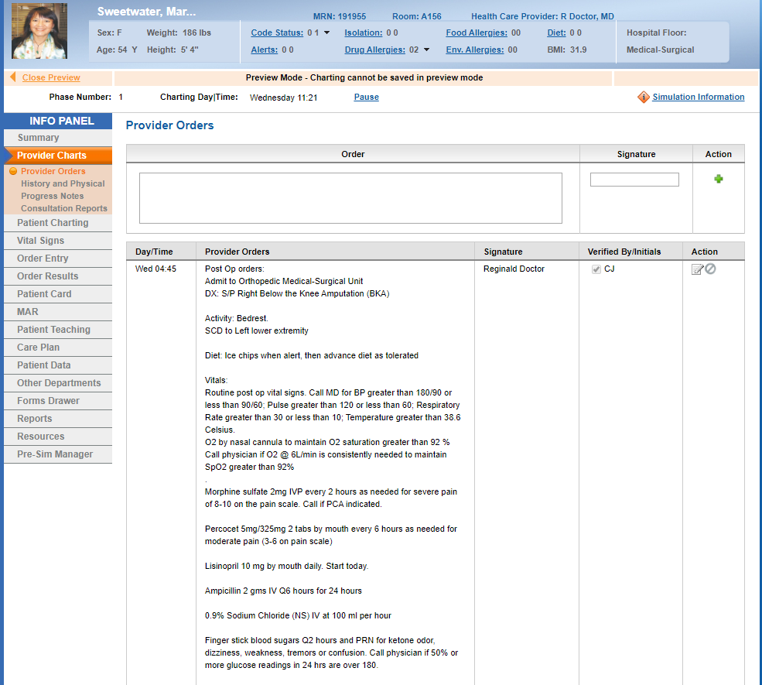
SimChart Medication Administration Steps using e-MAR
1. Click here to access patient’s e-MAR

Slide 20
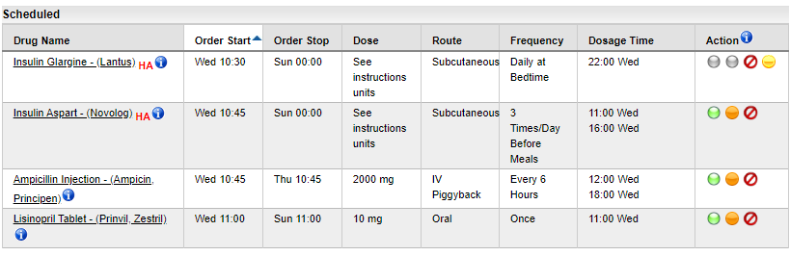
SimChart Medication Administration Steps using e-MAR Continued…
2. To administer a medication, click the green circle
Administer medication with an active order
i
MicroMedex Medication Information/Education
Hold medication
Discontinue medication.

Slide 21
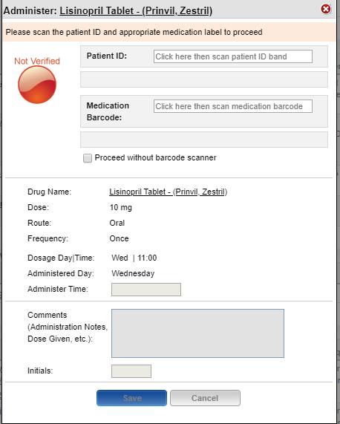
SimChart e-MAR Orientation Continued…
3. Click in box prior to verbalizing scanning patient ID band. After clicking, verbalize the use of barcode scanner to scan ID band.
4. Click in box prior to verbalizing scanning patient medication label. After clicking, verbalize the use barcode scanner to scan med label.
5. Check box here to proceed with virtual medication administration
6. Perform 3rd medication check using 6 rights
7. Enter medication administration time according to time in SimChart
8. Enter initials after performing medication checks
9. Click save and administer medication to patient

Slide 22
IV, Injection, and IV Pump Virtual Medication Administration Practice
Practice using drag and drop/annotation to perform other forms of medication administration

Slide 23
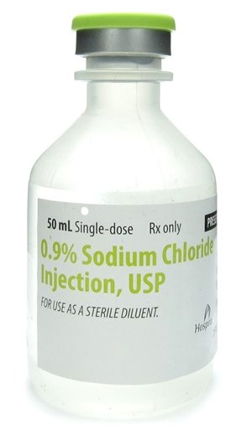
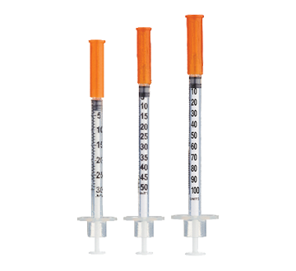


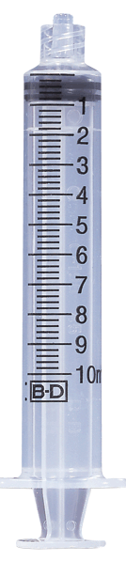
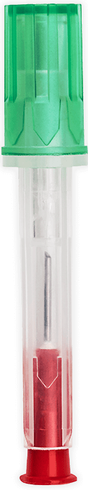
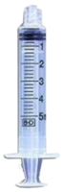

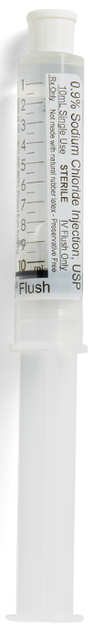
Medication Administration Practice Steps
Verbalize to Simulation Nurse which syringe you would use to prepare medication.
Use annotation draw feature to show how many ml of medication you would draw up
Label your medication syringe appropriately using the annotation text feature
4. Ensure you are verbalizing all of your med checks
a. Review your Performance Skills Checklists if you have questions
*See next slide for completed example*
Medication Label

Slide 24
Medication Administration Practice Steps: Completed Example
Verbalize to Simulation Nurse which syringe you would use to prepare medication.
Use annotation draw feature to show how many ml of medication you would draw up
Label your medication syringe appropriately using the annotation text feature
4. Ensure you are verbalizing all of your med checks
a. Review your Performance Skills Checklists if you have questions
Medication Label
Patient Sparky Devil
Sodium Chloride 1.5ml IV, once now
X/X/XXXX 0000 SN

Slide 25


Medication Administration
Use annotate draw feature to demonstrate location of medication administration
  Review your Performance Skills Checklists if you have questions
  *See next slide for completed example*

Slide 26
Medication Administration: Completed Example
Use annotate draw feature to demonstrate location of medication administration
  Review your Performance Skills Checklists if you have questions

Slide 27
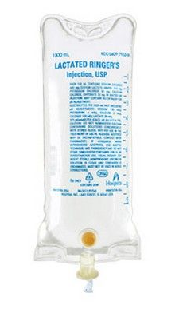

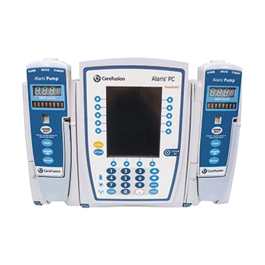
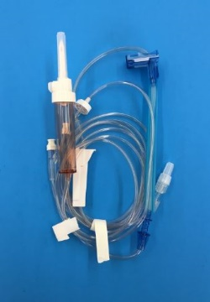
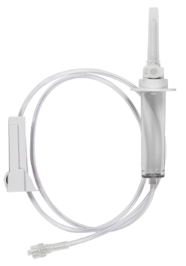
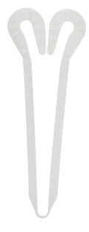

Drag and Drop
Practice dragging and dropping supplies for administration
Fill in required drug information on black “screens” on Alaris pump
*See next slide for completed example*
ml/hr
Drug:
Rate: mL/hr
VTBI: ml
ml/hr
DRUG
DRUG

Slide 28
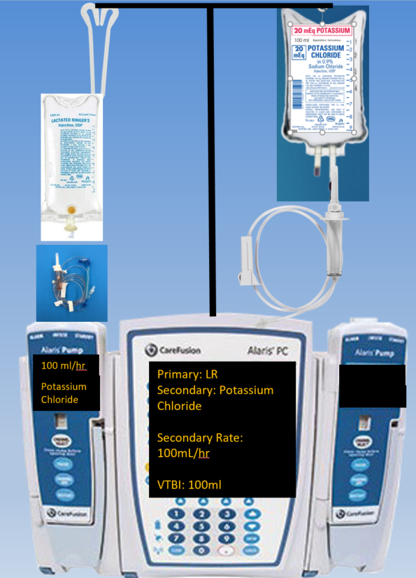
Drag and Drop: Completed Example
Practice dragging and dropping supplies for administration
Fill in required drug information on black “screens” on Alaris pump

